Slide 1
Regional Economic Integration Video http://www.youtube.com/watch?v=Y2X3KPilAt0&feature=channel&list=UL

Slide 2
Regional Economic Integration
Agreements among countries in a geographic region to reduce, and ultimately remove, tariff and non-tariff barriers to the free flow of goods, services, and factors of production between each other

Slide 3
Levels of Economic Integration
Video – Trade Blocs

Slide 4
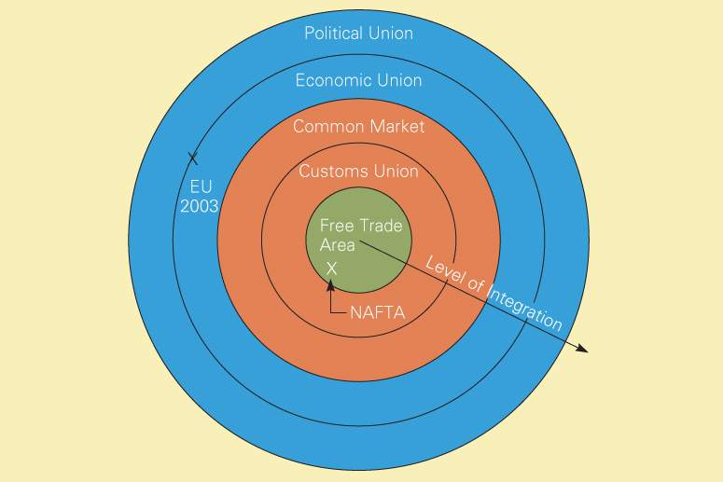
Levels of Economic Integration
Fig 8.1

Slide 5
Free Trade Area
All barriers to trade among members removed
Ideally, no discriminatory tariffs, quotas, subsidies, or administrative difficulties are allowed to restrict trade between members
Each country has its own trade policies toward non-members
Video -

Slide 6
Levels of Economic Integration
Fig 8.1

Slide 7
Customs Union
Eliminates barriers among members and has a common external trade policy
Establishment of a common external trade policy requires a significant administrative system to oversee trade relations with non-members
Most countries who enter a customs union have future aspirations of further economic integration

Slide 8
Levels of Economic Integration
Fig 8.1

Slide 9
Common Market
No trade barriers between members, a common external trade policy and allows production factors to move freely among members
Labor and capital are free to move because there are no restrictions on immigration, emigration, or cross-border flows of capital between member countries
Requires a significant degree of harmony and cooperation on fiscal, monetary, and employment policies

Slide 10
Levels of Economic Integration
Fig 8.1

Slide 11
Economic Union
No trade barriers among members, common external policy, free flow of production factors, adoption of common currency, harmonization of tax rates, and a common monetary and fiscal policy
Such a high degree of integration
demands a coordinating bureaucracy
sacrifice of significant amounts of national sovereignty

Slide 12
Levels of Economic Integration
Fig 8.1

Slide 13
Political Union
Coordinating bureaucracy accountable to all citizens of member nations
Central political system that coordinates the economic, social, and foreign policy of the member states

Slide 14
Economic Case for Integration
Unrestricted trade allows countries specialize in those goods and services they efficiently produce
increases world production
stimulates economic growth
Unrestricted FDI allows for the transfer of technology and management skills
increases economic growth
Attempt to achieve gains from free trade and FDI that goes beyond the international agreements such as WTO

Slide 15
Political Case for Integration
Economic interdependence
creates incentives for political cooperation
reduces potential for violent confrontation
Linked countries have more political and economic influence with other countries or trading blocs

Slide 16
Impediments to Integration
Although a nation as a whole may benefit, groups within a nation may be harmed
Concerns about national sovereignty
Protection of cultural identity
Socioeconomic gap between rich and poor nations
Impact of new members

Slide 17
Case Against Regional Integration
The benefits outweigh the costs only if the amount of trade it creates exceeds the amount it diverts.
Trade Creation
low-cost producers within the FTA replace high-cost domestic producers
lower cost external producers within the FTA replace higher cost external producers
Trade Diversion
higher cost suppliers replace lower cost external suppliers within the FTA

Slide 18
Regional Economic Integration in Europe
Europe has two trade blocks
European Union
27 members
European Free Trade Association
4 members

Slide 19
Evolution of the European Union
Drivers of European Regional Integration
Devastation of WWI and WWII and desire for lasting peace
Desire for European nations to hold their own, politically and economically, on the world stage
Desire to receive the economic gains from regional integration

Slide 20
Current Achievements of the EU
Dec 1991 Maastricht Treaty
-changed name to European Union -embarked on creation of Euro
Dec 31, 1992 Single European Act
Jan 1, 1999 Euro adopted
Jan 1, 2002 Euro coins and notes issue
2004 Expansion with 10 new members
2007 Expansion to 27 members

Slide 21
Political Structure of the EU
Video

Slide 22
The Euro

Slide 23
The Euro
Maastricht Treaty
Signed in December 1991
Committed members to adopt a common currency
Adopted in January 1, 1999 by 12 of the 15 members
Other member nations may follow

Slide 24
Benefits of the Euro
Savings from using only one currency
Easier to compare prices across Europe
Increases competition
Forces firms to cut costs and increase efficiency
Creates liquid pan-Europe capital market
Increases range of investments opportunities for individuals and institutions

Slide 25
Costs of the Euro
Countries lose national monetary policy control to the European Central Bank
EU is not an “optimal currency area”
where similarities in the underlying structure of economic activity make it feasible to adopt a single currency and use a single exchange rate as an instrument of macroeconomic policy
Euro zone country economies are very dissimilar
Putting the “economic cart before the political horse”?

Slide 26
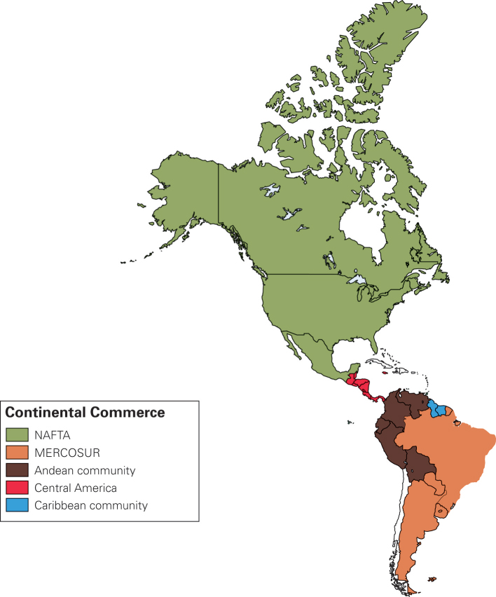
Regional Economic Integration in the Americas
Some success and nowhere near the level of the EU
NAFTA
MERCOSUR
Andean Community
Plans for FTAA

Slide 27
North American Free Trade Agreement

Slide 28
NAFTA
Started with Canada and USA in 1989
Followed with NAFTA in January 1, 1994
Tariffs reduced in 10 years (99% of goods traded)
End most barriers on cross border flow of services
Removal of restrictions on FDI except in:
Mexican railway and energy
US airline and radio communications
Canadian culture
Application of national environmental standards
Protection of intellectual property rights

Slide 29
Case for NAFTA
Enlarges more efficient regional productive base
US and Canadian firms tap labor-intensive low-wages
Mexico receives FDI and employment
Increases Mexican income to buy US/Canada goods
Demand for US/Canada goods increases jobs
Increases competitiveness of US/Canadian firms

Slide 30
Case against NAFTA
Loss of jobs to Mexico
Mexican firms have to compete against efficient US/Canada firms
Environmental degradation
Loss of national sovereignty for all countries
Creation of a “Northern State” in Mexico

Slide 31
Effects of NAFTA (1993-2005)
Overall impact has been small but positive
Trade between NAFTA members increased 250%
All 3 members experienced productivity gains
Employment effects of NAFTA have been small
NAFTA nurtured political stability in Mexico
Expansion of NAFTA with Chile?

Slide 32
Regional Economic Integration in Asia

Slide 33
Regional Economic Integration in Asia
Association of Southeast Asian Nations (ASEAN)
Asia-Pacific Economic Cooperation (APEC)

Slide 34
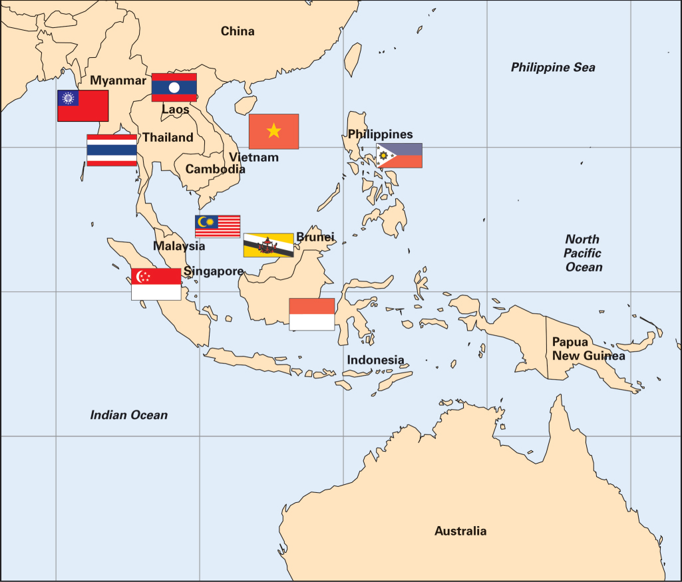
Association of Southeast Asian Nations (ASEAN)

Slide 35
Association of Southeast Asian Nations (ASEAN)
Created in 1967
500 M people with combined GDP of $740 B
Goal to foster “freer trade” between members and cooperate in their industrial policies
ASEAN Free Trade Area (AFTA) by 6 nations formed in 2003
Progress limited by:
failure by members to lower tariffs
members can’t agree to a common external tariff
1997 Asian financial crisis
predominance of old, mediocre private conglomerates
challenge from China and “shift to the north”

Slide 36
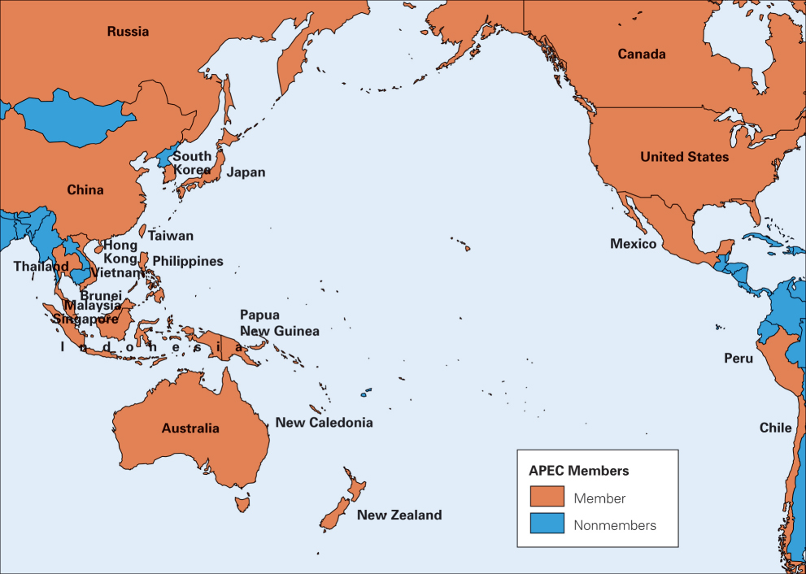
Asia Pacific Economic Cooperation (APEC)

Slide 37
Asia Pacific Economic Cooperation (APEC)
Founded in 1990
21 members that account for:
57% of global GNP
46% of global trade
majority of growth in world economy
Despite slow progress, if successful, could become the world’s largest free trade area

Slide 38
Regional Trade Blocs in Africa
9 trade blocs on the continent
Many countries are members of more than one bloc
Progress slow due to political turmoil and deep suspicion of free trade and impact on poorest nations
In 2001, reestablished the East African Community
Kenya, Uganda and Tanzania
Goal is customs union 24 years after collapse

Slide 39
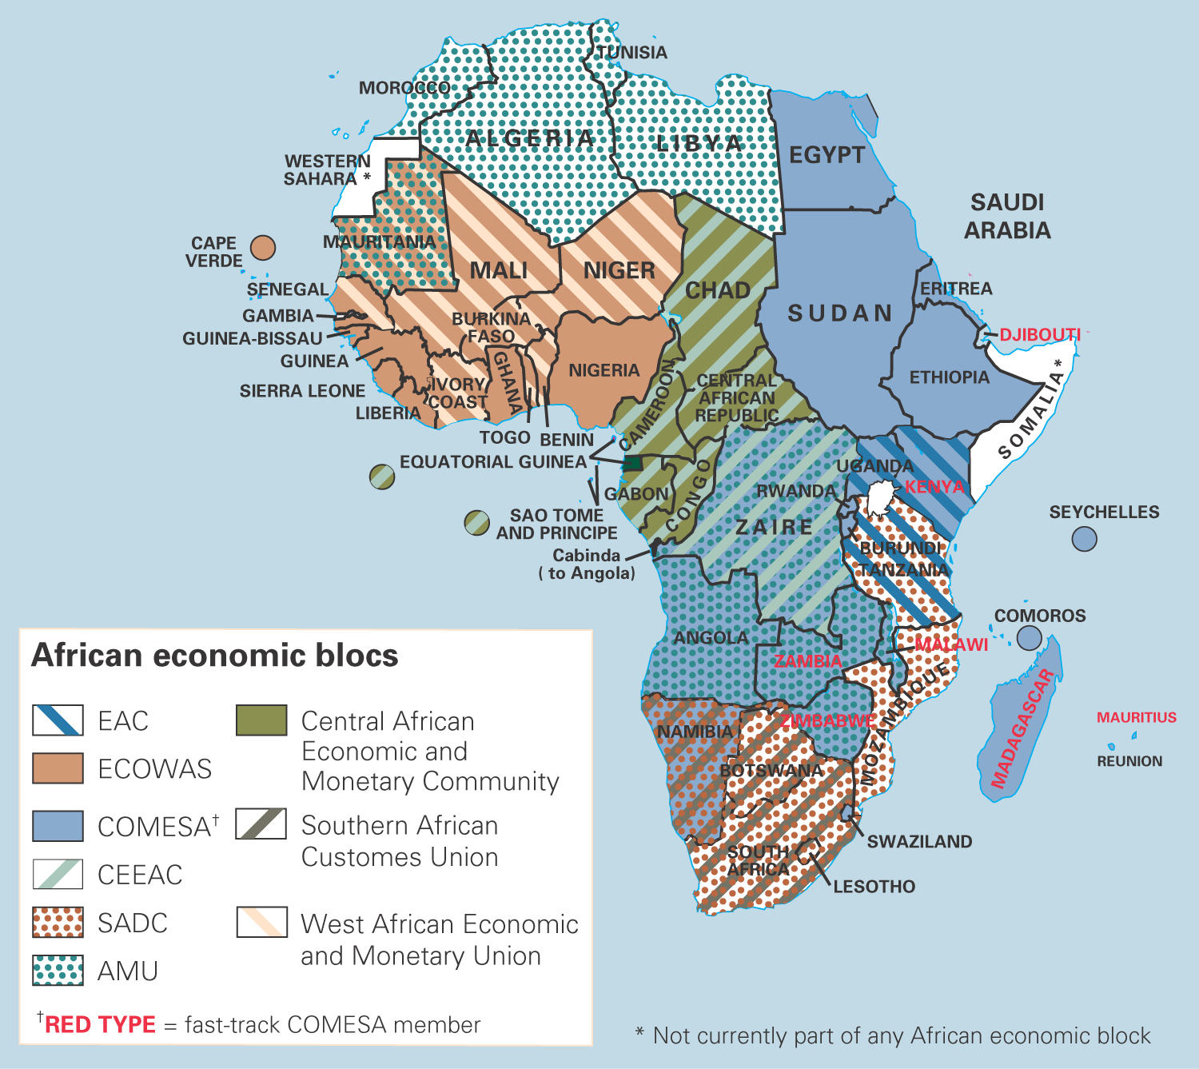
Regional Trade Blocs in Africa

Slide 40
Regional Economic Integration
Impact on Business
Opportunities
Creation of large single markets
Protected markets are now open
Lower costs doing business in single market
Threats
Differences in culture and competitive practices make realizing economies of scale difficult
More price competition
Outside firms shut out of market via “trade fortress”
EU intervention in mergers and acquisitions

